Slide 1
Capstone Project: Hearing Centre Submission Form Analysis
Before and After in Data Analysis
By Daniel Hill

Slide 2

What is a Data Analyst’s best friend?
Spreadsheets
Pivot Tables
Graphs

Slide 3
Table of content
Task
‘Before’ state
‘After’ state
Summary

Slide 4

Task
Who is the client?
What is the question?
How many form submissions about ‘X’ service are we getting?
What are the topics we are seeing in the submission forms?

Slide 5
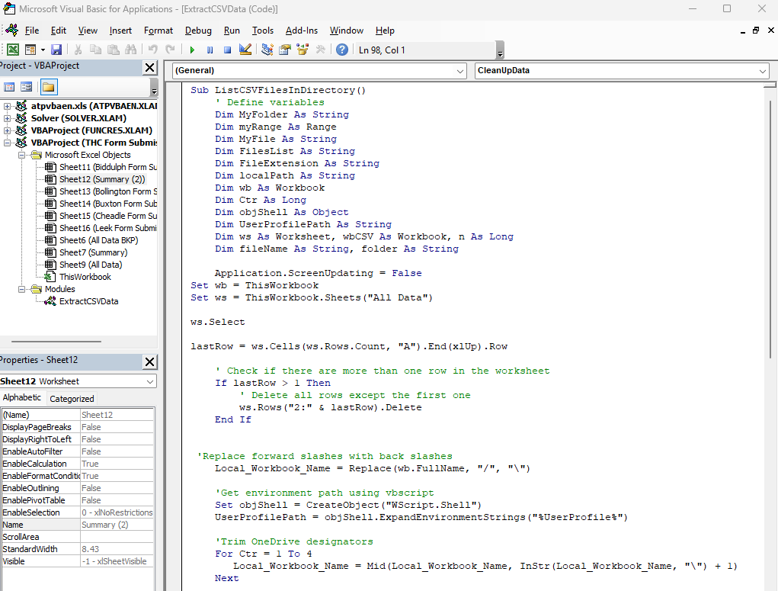
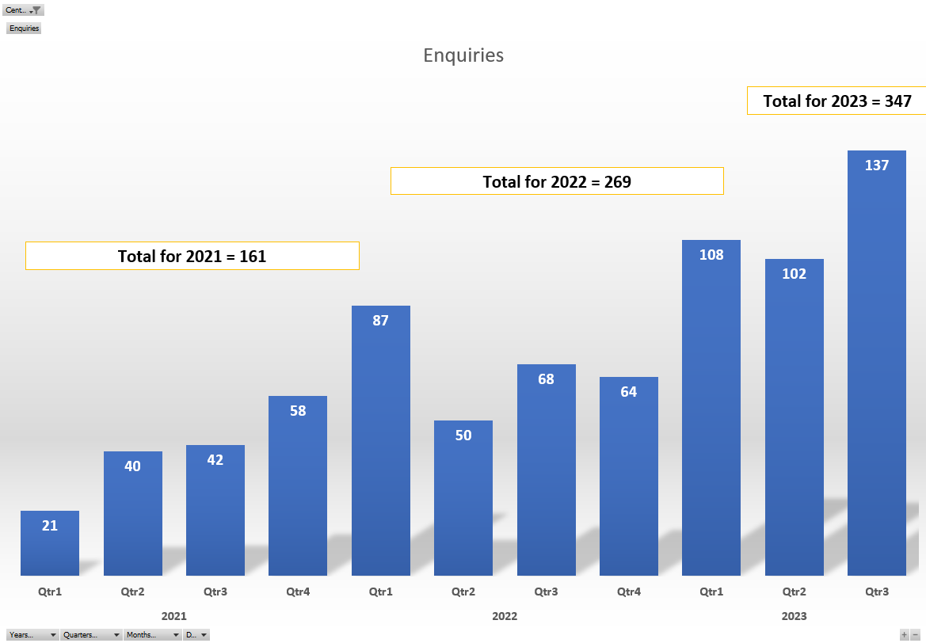
‘Before’ state
Features
Categorises entries
Removes spam and duplicates
Filters per location
Limitations
New data upload
Manual spam filter update
No further insights

Slide 6

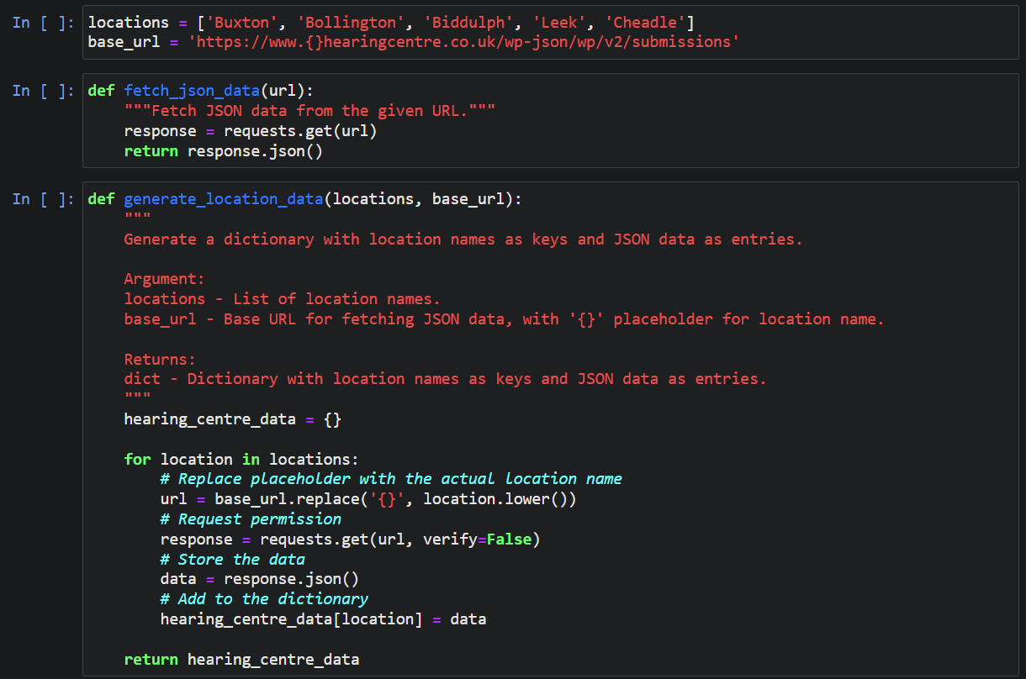
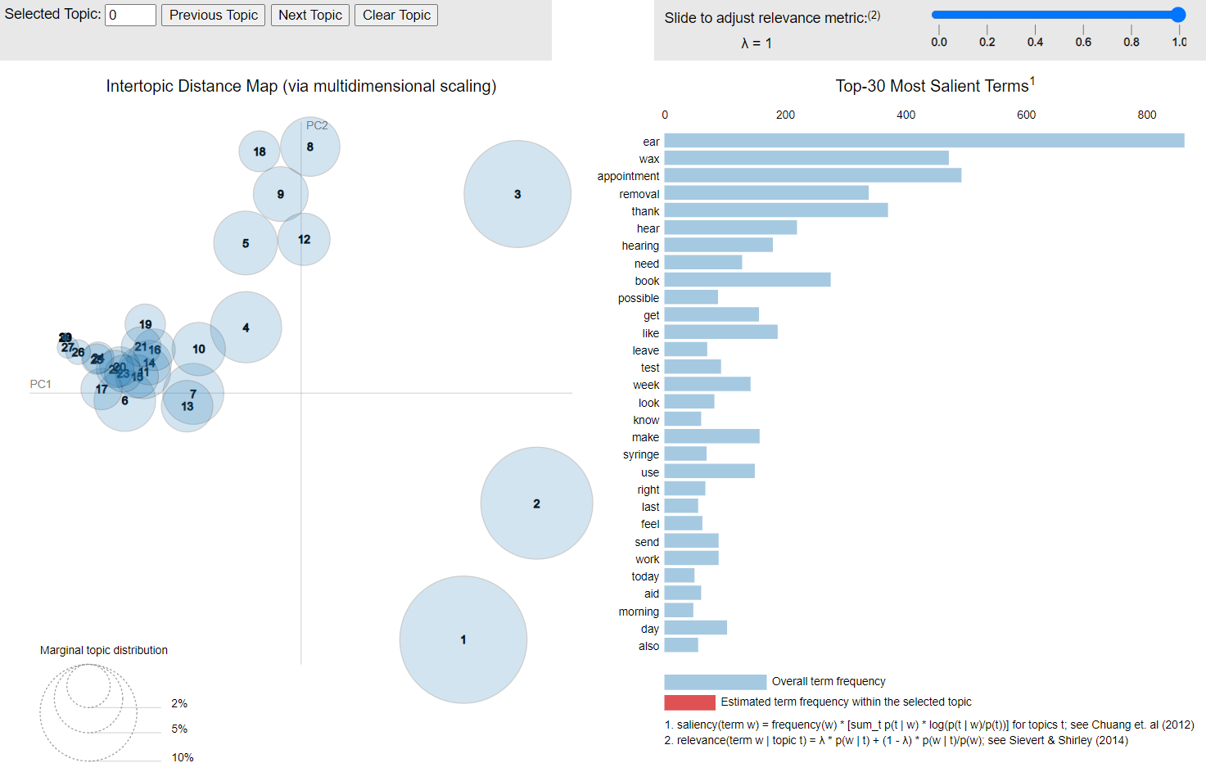
‘After’ state
New Data
Endpoint API
Scalable
Spam Filter
Count Vectorizer model
Easy update and tunning
No ‘word conflict’
Insights
Most common terms
Combinations
New topics emerging
Direct download

Slide 7
Summary
Positives:
All 3 major targets accomplished
System is scalable
Maintenance and update time significantly reduced
Further insight avenues available
Points of improvement:
Proof of Concept
Spam filter can be optimised further
Clearer output report
Data protection pipeline improvement

Slide 8
Thank for your time and attention!

